Slide 1
David J. Shea, CPCM, PMP Director Center for Charge Card Management (CCCM)
GSA SmartPay® 2023 Program Update Emergent Issues, Opportunities and Challenges from the Program Manager’s Perspective

Slide 2

Agenda
CCCM Core Objectives
25th Anniversary Significance
Evolution of Increased Flexibility
GSA SmartPay® Program Historical Spend and Refunds
Spend Across Program Generations
Program Performance Trends and Observations
Program Updates
OMB Memos on New Suppliers and TikTok Ban
GSA SmartPay 889 SAM “Easy Search” Tool
On the Horizon….
Maximizing Program Value
Travel and Fleet Card Trends
Wrap-up/Closing

Slide 3
CCCM Core Objectives
GSA SmartPay 3 is designed to support participating organizations through FY 2031
CCCM’s overall objectives:
Continue driving contractor bank performance optimization to ensure world class service and modern, secure and easy-to-use payment solutions
Pursue key opportunities to increase agency program benefits
Stay focused on process simplification and payment friction reduction
Work closely with contractor banks to maintain strong system security posture and encourage remaining participating agencies not yet using Multi-Factor Authentication (MFA) to transition to it
Continuously evolve training and data products
Maintain close relationships with participating agencies

Slide 4
25th GSA SmartPay Anniversary Significance
Know that YOU are in important part of a revolution in mission support and administrative management!
At the request of OMB, GSA laid the groundwork establishing the government-wide GSA SmartPay program in the mid 1990s.
The program evolved out of initial card use efforts by Departments of Defense, Commerce, Transportation, the General Services Administration, and others
Creation of the highly deregulated micro-purchase category of acquisition through the Federal Acquisition Streamlining Act of 1994 and the mandate for Federal travelers to use travel cards as a result of the Travel and Transportation Reform Act of 1998 were key
Prior to GSA SmartPay:
Contacting/procurement offices were overwhelmed with relatively small dollar purchase requests that often took months to process
Travelers had to obtain cash advances before going on travel and carry cash
Agencies placed purchase orders with service stations for fuel

Slide 5
Evolution of Increased Flexibility
The first MPT was established in 1994 through the Federal Acquisition Streamlining Act (FASA).
Since that time, the “routine” MPT has been adjusted four times.
Additionally, multiple MPTs were created to address specific purchasing activities, entities, and/or conditions.
FAR 13.301(b) also states that agencies may not limit card use to micro-purchases.
Note: Davis-Bacon and Related Acts and Service Contract Labor Standards (formerly McNamara-O’Hara Service Contract Act) thresholds remain unchanged ($2,000 and $2,500, respectively).
$2,500
FY 1994 - FASA
$20,000 within U.S.
FY 1998 – Stafford Act; Contingency Prep and/or Response Except Construction ($35,000 outside U.S.)
$3,000
FY 2010 – FAR Economic Threshold Adjustment
$3,500
$5,000
FY 2015 – FAR Economic Threshold Adjustment
FY 2017 – NDAA; Increase in DoD MPT (DoD Only)
$10,000*
FY 2017 – NDAA; DoD R&D and Institutions of Higher Education (DoD R&D & Civ)
*or as determined by head of institution
$10,000
FY 2018 – NDAA Section 806 (Civ only)
$25,000
Proposed but not enacted for the GSA e-commerce portal (approved commodities only)

Slide 6
Since inception, GSA SmartPay has enabled over $642B in total spend through 2.0B transactions, generating over $5.7B in agency refunds.
GSA SmartPay 1 Begins
GSA SmartPay 2 Begins
Fleet: $32B
Travel: $166B
Purchase: $412B
Agency Refunds

Slide 7
Into a 3rd Generation of GSA Smartpay Program Growth
 | SmartPay 1 | SmartPay 2 | SmartPay 3
Purchase Spend: | $158.7B | $190.7B | $85.0B
Travel Spend: | $63.2B | $84.9B | $25.5B
Fleet Spend: | $9.0B | $18.9B | $6.6B
Total Spend: | $230.9B | $294.5B | $117.2B
Total Transactions: | 849.0M | 946.5M | 297.2M
Cumulative Agency Refunds: | $1.1B | $3.0B | $1.6B

Slide 8
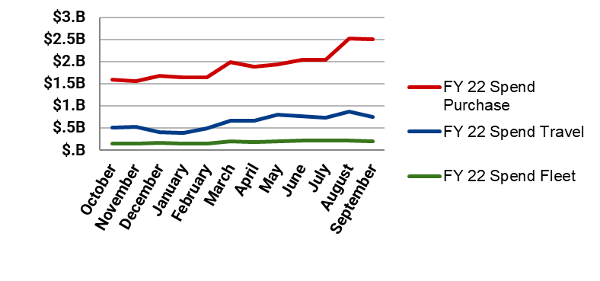
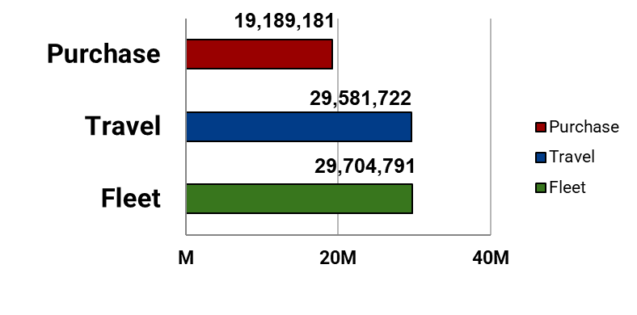
FY22 Program Statistics
Spend
Total Spend:
$32.8B
Total Transactions:
78.5M
12.2% vs. FY21.
12.9% vs. FY21.
Total Refunds:
$426.5M
Total Accounts:
6.6M
9.4% vs. FY21.
5.46% vs. FY21.
Transactions
Accounts

Slide 9
Overall Program Performance Trends/Observations
Purchase card spend performance remained largely consistent during the pandemic and continues to increase
FY 22 purchase card spend increased by 4.7% year over year; the number of accounts increased by 10%
Spend with small business exceeds 30% of purchase card spend based on commercial data
Purchase card is a great procurement and payment method (within the MPT) to attract new and small businesses to the Federal supplier base.
Travel spend was up significantly in FY 22 and continues to increase thus far in FY 23
Airline, hotel and rental car costs and spend are up significantly due to increased costs of these services
Travel has not fully recovered from a # of trips perspective
FY 22 Fleet spend was up significantly as well primarily due to increasing fuel prices.
Overall, participating organization refund revenue (“cash back”) continues to be significantly above SP1 or SP2 levels.

Slide 10
Quick Updates
OMB Memorandum M-23-11 dated 2/17/23 entitled “Creating a More Diverse and Resilient Federal Marketplace through Increased Participation of New and Recent Entrants” – The GSA SmartPay program is not mentioned in the memorandum itself, but rather in the FAQs:
…[T]he participation and contribution of entities to Federal Supply chains that are transacting solely through MPT purchases should be understood, recognizing that this activity can be a gateway for some entities to do more substantial work with the Federal marketplace in the future.
CCCM is exploring the development of a data warehouse based “new micro-purchase vendor” report for agency HQ card managers

Slide 11
Quick Updates (Continued)
Addressed in OMB Memorandum M-23-13, dated 2/27/23 entitled “No TikTok on Government Devices” Implementation Guidance
Subject of draft FAR Case 2023-010, “Prohibition on Using a Covered Application”
TikTok is a free software application (“app”) owed and operated by ByteDance, Limited, which is headquartered in China.
The app is free
Includes an in-app purchasing capability
As of the date of this presentation, the draft FAR case is out for agency comment only
Not releasable to the public Final version not yet available
Potential impact micro-purchasing procedures, if any, remains to be determined

Slide 12
New GSA SmartPay 889 “Easy Search Tool”
CCCM deployed a new, easy-to-use 889 SAM search tool designed for use by customer agency micro-purchase cardholders.
This will help the majority of the 1 million agency GSA SmartPay purchase cardholders who are non-procurement personnel.
The search tool was developed by a team at NASA then refined by GSA’s Service Delivery team.
In its first phase, the tool will search System for Award Management (SAM) data for 889 representations on file for the requested vendor.
Note that vendors only doing business with the Micro-Purchase Threshold are not required to register in SAM
The lack of SAM information, or the need to research a vendor’s use of prohibited technology does not necessarily exclude them from a purchase
Cardholders need to adhere to agency policy, as applicable
Planned future capabilities include the ability to upload customer agency obtained representations from micro-purchase vendors. This will not only help agency purchase card holders, but industry as well. Industry won’t have to repeatedly provide this information to individual buyers, because the information will be centrally available.

Slide 13
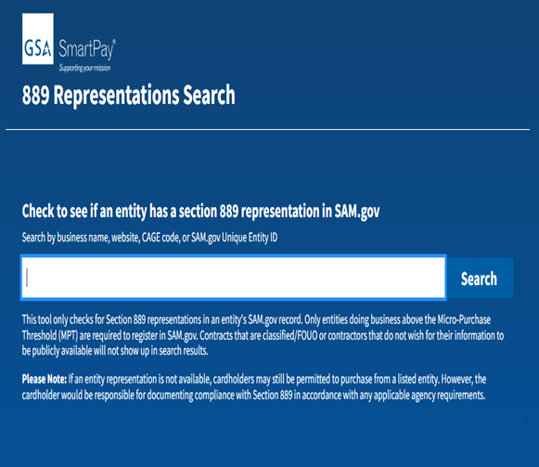
New GSA SmartPay 889 “Easy Search Tool”

Slide 14
On the Horizon: New GSA SmartPay Website
CCCM is working with customer agencies and the GSA Service Delivery Team to improve and modernize the GSA SmartPay website (smartpay.gsa.gov)
Developed using agile techniques
Expected to launch in FY 24
Includes:
Streamlined are reorganized content
Improved training content with “loginless” access
Improved security

Slide 15
Maximizing Program Value
Purchase Card:
FAR part 13 requires agencies to maximize use of “simplified acquisition procedures,” of which micro-purchasing is a component
Agency HQ’s should review FPDS data for your organization’s spend at $10K and below for transactions not indicating card use; address further opportunities for streamlining and savings
FAR subpart 13.3 states agencies should NOT limit use of the purchase card to micro-purchases (emphasis added)
Agency HQ’s should consider servicing contractor bank Accounts Payable (A/P) reviews to start dialog re: identifying additional opportunities both below and above the MPT for savings.

Slide 16
Maximizing Program Value (Continued)
Purchase Card:
Encourage cardholder use of existing government ordering vehicles and best-in-class contract sourcing -- can assist with 889 compliance issues
Continue to encourage buying from small businesses when possible -- FY 21 small business transaction activity exceeded 30% of annual purchase card spend
Consider leveraging GSA Commercial Platform program (see: https://www.gsa.gov/buying-selling/purchasing-programs/commercial-platforms)
If not already available, advocate for changes to your organization’s procurement automation and financial systems (as appropriate) to provide an option for payment by card.
Maximize purchase card use for inter-governmental spend – purchase card can currently be used for transactions up to and including $9,999 per the Treasury Financial Manual (TFM). Card use is the fastest, simplest means of interagency purchasing – no complex forms, terms or conditions required.

Slide 17
Increasing Carded Contract Payments
While not all contractors accept carded payments, increasing these payments continue to be the single largest opportunity for agencies to garner further GSA SmartPay program benefits
Contract payments totaled more than $3 billion in FY 22
Agencies need to ensure warranted Contracting Officers, authorized ordering officials, payment office officials, etc. have cards in hand to help support increased use for contract payments while maintaining reasonable internal controls
Requiring card acceptance for payments above MPT is best done at solicitation stage. Conversion later can be challenging.

Slide 18
Not for Micro-Purchases Only!
FAR 31.301:
(b) Agency procedures should not limit the use of the Government wide commercial purchase card to micro-purchases. Agency procedures should encourage use of the card in greater dollar amounts by Contracting Officers to place orders and to pay for purchases against contracts established under part 8 procedures, when authorized; and to place orders and/or make payment under other contractual instruments, when agreed to by the contractor. See 32.1110(d) for instructions for use of the appropriate clause when payment under a written contract will be made through use of the card. (Excerpted text; emphasis added)

Slide 19
Make Carded Contract Payments Without the Clause!
FAR 32.1110 Solicitation/Contract Prescription and Contract Clauses
(d) If payment under a written contract will be made by a charge to a Government account with a third party such as a Government-wide commercial purchase card, then the contracting officer shall insert the clause at 52.232-36, Payment by Third Party, in solicitations and contracts. Payment by a purchase card may also be made under a contract that does not contain the clause at 52.232-36, to the extent the contractor agrees to accept that method of payment. When the clause at 52.232-36 is included in a solicitation or contract, the contracting officer shall also insert the clause at 52.232-33, Payment by Electronic Funds Transfer-System for Award Management, or 52.232-34, Payment by Electronic Funds Transfer-Other Than System for Award Management, as appropriate. (Excerpted text; emphasis added)

Slide 20
What? No Prompt Payment Penalties?
FAR 52.232.-36 Exempts Carded Payments from Prompt Payment Act requirements:
(c) Payment. …Payments made or due by the third party under this clause are not payments made by the Government and are not subject to the Prompt Payment Act or any implementation thereof in this contract…. (Excerpted text; emphasis added)

Slide 21
Travel and Fleet Card Trends
Travel Cards:
Increased use of virtual accounts
Especially for international lodging
Account numbers are valid for a specific time period only
Especially good for use in locations with weak transaction security
Note not all electronic travel management systems can yet support
Agency HQ determines virtual account availability
Fleet Cards:
As fleets move to EVs, consider how payments for charging will be made. Considerations to start thinking through:
Take home vehicles use case – how to pay
Preserving fleet refund revenue

Slide 22
Appreciation
Thanks for your time and attention!
Have a great forum!
david.shea@gsa.gov

Slide 23

GSA Starmark Logo

